Slide 1
One-class Support Vector Machine (SVM)
Chris Kuo, Ph.D.| Columbia University

Slide 2
Let’s start with Support Vector Machines (SVM)
Traditionally, many classification problems try to solve two or multi-class situation.
SVMs, support vector machines, are supervised learning models for classification. They train the data to model a target with two or multiple classes.

Slide 3
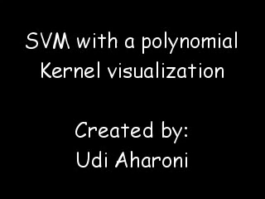
Basic concepts of SVM
Traditionally, many classification problems try to solve the two or multi-class situation. The goal of the machine learning application is to distinguish test data between a number of classes, using training data.

Slide 4
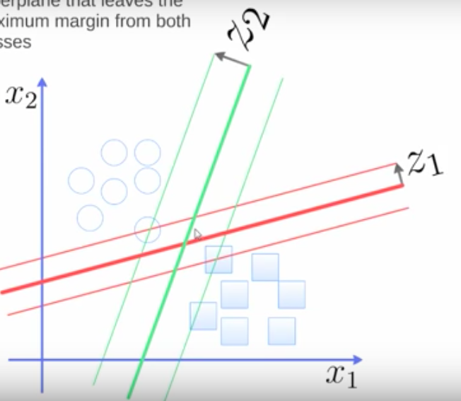
Basic concepts of SVM
Assume there are only two features.
In theory there will be many hyperplanes that can separate the two classes. Which hyperplane is the best solution? The best choice will be the hyperplane that leaves the maximum margin from both classes.
The green margin is bigger than the red margin.

Slide 5
Q. What if the target has only one class?
Statement of the problem
Notes:
This is the question that your experiment answers

Slide 6
Examples for data of one-class
In medical applications, a doctor may know what healthy (normal) cases look like and want to distinguish the "abnormal" cases from the "normal" cases.
But to collect abnormal data can be rather expensive or just impossible.
Although we may try to simulate all the abnormal data, there is no way to guarantee that all the abnormal data are simulated and thus recognized in a traditional two-class problem.

Slide 7
From two-class SVM to One-class SVM
To cope with this problem, one-class classification problems (and solutions) are introduced.
By just providing the normal training data, an algorithm creates a representational model of this data.
If newly encountered data is too different, according to some measurement, from this model, it is labeled as out-of-class.

Slide 8
One-Class SVM according to Tax and Duin (2004)
The one class support vector machine was introduced independently by Tax and Duin and Scholkopf et al. as an extension of the support vector machine algorithm.
It has gained much popularity in unsupervised learning for high-dimensional data.
The one-class SVM first trains the model with normal data. When new data come, the model looks at the relative positions to the "normal" data to determine whether it is "out of class" or not.
One-class SVMs will label a normal data point as '1' and the outlier point as -1.
Notes:
Summarize your research in three to five points.

Slide 9
Q. The algorithms of One-class SVM
Statement of the problem
Notes:
This is the question that your experiment answers

Slide 10
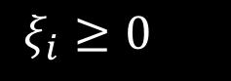
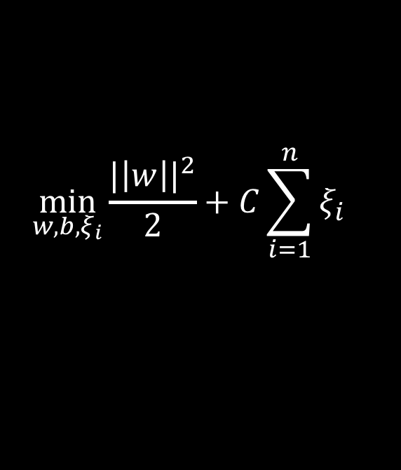
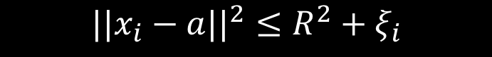
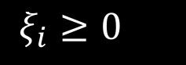
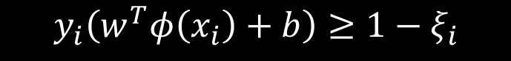
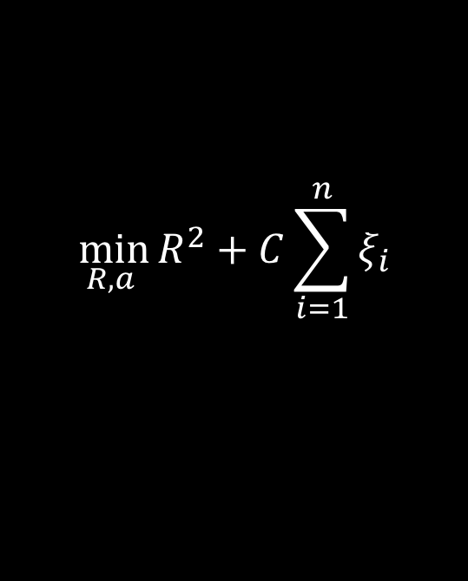
One-Class SVM according to Tax and Duin (2004)
SVM
One-class SVM
$$\min_{w,b,ξ_{i}}{\frac{{|\left|w\right||}^{2}}{2}}+C\sum_{i=1}^{n}{ξ_{i}}$$
$$\min_{R, a }{R^{2}}+C\sum_{i=1}^{n}{ξ_{i}}$$
subject to
subject to
$$||x_{i}−a{||}^{2}≤R^{2}+ξ_{i}$$
$$y_{i}\left(w^{T}φ\left(x_{i}\right)+b\right)≥1−ξ_{i}$$
$ξ_{i}≥0$
$ξ_{i}≥0$
for all i=1, …, n
for all i=1, …, n
Notes:
Summarize your research in three to five points.

Slide 11
Works Cited
Tax and Duin

